Slide 1
Computer Vision
Part 2: Deep Learning Architecture
ADF

Slide 2

Agenda
Part 1: Feature Learning
AutoEncoder
Transfer Learning
Part 2: Deep Learning Architectures
Famous Architectures
ImageNet Winner 2012-2018
Computer Vision

Slide 3
ILSVRC Challenge
CNN
Classification error
Beat human
Lin et al | Sanchez & Peronin
HOG+LBP+SVM | FV+PQ+SVMs
Krizhevsky et al | Zeliler & Vergus | Simonyan & Zisserman | Szegedy et al
(AlexNet) | (ZF-Net) | (VGG) | (GoogLeNet)
He et al | Shao et al | He et al
(ResNet) | ensemble | (SENet)
Russakovsky et al
Computer Vision
Notes:
Imagenet large scale visual recognition challenge
1000 object classes, over 1.4 mil images
2012 : year the winning of imagenet challenge is convolutional neural network
CNN was not invented in 2012, but invented in 70-80s,
CNN Showed massive power as high capacity end-to-end training architecture and won the imagenet challenge by huge amount
Beginning of Deep Learning Revolution

Slide 4
Back-to-back Case Studies
Computer Vision

Slide 5
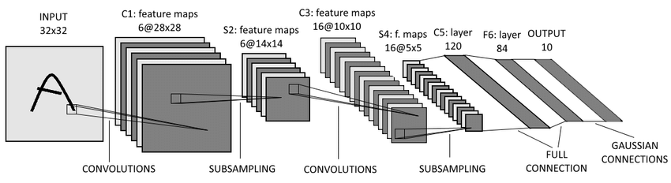
LeNet-5
[LeNet-5, LeCun 1980]
Computer Vision
Notes:
Ma x pooling

Slide 6
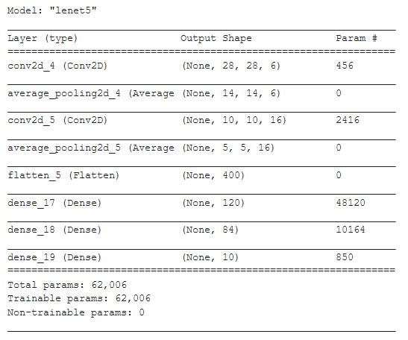
LeNet-5 Details
5 layers
Input 32x32
Conv1 6 @ 5x5, stride 1
Average Pool
Conv2 16 @ 5x5, stride 1
Average Pool
FC3 120
FC4 84
FC5 10
Total parameters 62K
Pretraining unavailable
[LeNet-5, LeCun 1980]
Computer Vision
Notes:
Ma x pooling

Slide 7
2012
Computer Vision

Slide 8
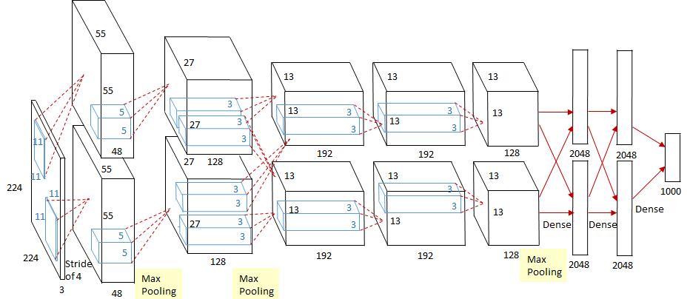
AlexNet
[Krizhevsky et al. 2012]
Computer Vision
Notes:
2 separate stream, Split on 2 GPU, device limitation issue at the time
Num parameter ~35K
Do not confused with the paper, in the paper Alex said that it was 224x224, but if we compute the stride, it won’t match

Slide 9
AlexNet
8 layers
5 Conv, 3 FC
MaxPool
Input 227x227x3
The paper said it was 224x224
But it didn’t match ( Conv1 96 @ 11x11, stride 4 )
Total parameters 62M
Pretraining unavailable
[Krizhevsky et al. 2012]
Computer Vision
Notes:
Ma x pooling

Slide 10
AlexNet Details
First popularize the use of ReLU
For each and every CONV and FC
Used Local Response Normalization layers (not common anymore)
Heavy data augmentation
Trained on 15 million annotated images from a total of over 22,000 categories.
Trained on two GTX 580 GPUs for five to six days.
Split neuron on each 3GB GPU memory
[Krizhevsky et al. 2012]
Computer Vision
Notes:
Heavy data augmentation : jarring, resize, changing it’s color a bit, hallucinating training data,

Slide 11
AlexNet Details
How to determine:
Filter size?
Filter number?
Conv-pool combination?
Trial and Error :(
INPUT |  | [227x227x3]
CONV1 | 96 @ 11x11, stride 4, pad 0 | [55x55x 96]
MAX POOL1 | 3x3, stride 2 | [27x27x 96]
NORM1 | Normalization layer | [27x27x 96]
CONV2 | 256 @ 5x5, stride 1, pad 2 | [27x27x256]
MAX POOL2 | 3x3, stride 2 | [13x13x256]
NORM2 | Normalization layer | [13x13x256]
CONV3 | 384 @ 3x3, stride 1, pad 1 | [13x13x384]
CONV4 | 384 @ 3x3, stride 1, pad 1 | [13x13x384]
CONV5 | 256 @ 3x3, stride 1, pad 1 | [13x13x256]
MAX POOL3 | 3x3, stride 2 | [ 6 x 6 x256]
FC6 | 4096 neurons | [ 4096 ]
FC7 | 4096 neurons | [ 4096 ]
FC8 | 1000 neurons (class scores) | [ 1000 ]
Usually called “FC7 feature”
[Krizhevsky et al. 2012]
Computer Vision
Notes:
There was normalization layer at the time
In practice doesn’t really matter

Slide 12

AlexNet Details
Connections with all feature maps in preceding layer, communication across GPUs in
CONV3, FC6, FC7, FC8
CONV1, CONV2, CONV4, CONV5:
Connections only with feature maps
on same GPU
[Krizhevsky et al. 2012]
Computer Vision
Notes:
2 separate stream, Split on 2 GPU, device limitation issue at the time
Num parameter ~35K
Do not confused with the paper, in the paper Alex said that it was 224x224, but if we compute the stride, it won’t match

Slide 13
ImageNet 2012
Classification Winner
Top-5 error: 18.2%
From 25.8%
7 CNN ensembles: 15.4%
Total Citations: 71,340
[Krizhevsky et al. 2012]
Computer Vision

Slide 14
AlexNet Details
Memory (KB) | Params (k) | Flops (M)
1,134.4 | 34.9 | 105.4
273.4 | - | -
- | - | -
729.0 | 614.7 | 447.9
169.0 | - | -
- | - | -
253.5 | 885.1 | 149.5
253.5 | 1327.5 | 224.3
169.0 | 885.0 | 149.5
36.0 | - | -
16.0 | 37,752.8 | 37.7
16.0 | 16,781.3 | 16.8
3.9 | 4,097.0 | 4.1
INPUT |  | [227x227x3]
CONV1 | 96 @ 11x11, stride 4, pad 0 | [55x55x 96]
MAX POOL1 | 3x3, stride 2 | [27x27x 96]
NORM1 | Normalization layer | [27x27x 96]
CONV2 | 256 @ 5x5, stride 1, pad 2 | [27x27x256]
MAX POOL2 | 3x3, stride 2 | [13x13x256]
NORM2 | Normalization layer | [13x13x256]
CONV3 | 384 @ 3x3, stride 1, pad 1 | [13x13x384]
CONV4 | 384 @ 3x3, stride 1, pad 1 | [13x13x384]
CONV5 | 256 @ 3x3, stride 1, pad 1 | [13x13x256]
MAX POOL3 | 3x3, stride 2 | [ 6 x 6 x256]
FC6 | 4096 neurons | [ 4096 ]
FC7 | 4096 neurons | [ 4096 ]
FC8 | 1000 neurons (class scores) | [ 1000 ]
Computer Vision
Notes:
There was normalization layer at the time
In practice doesn’t really matter

Slide 15
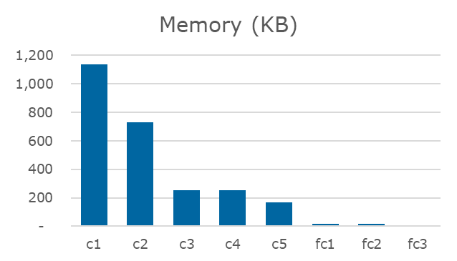
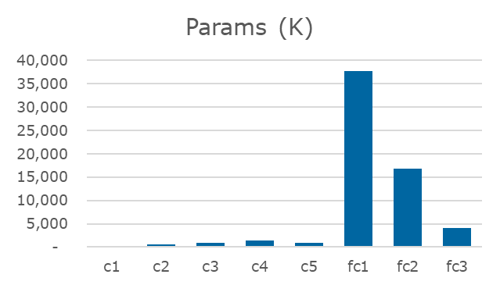
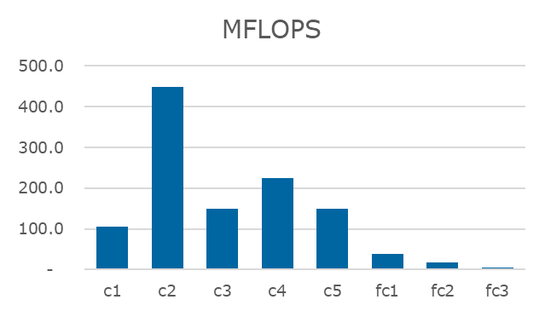
AlexNet Details
Most of the memory usage is in the early convolution layers
Nearly all parameters are in the fully-connected layers
Most floating-point ops occur in the conv layers
Computer Vision
Notes:
There was normalization layer at the time
In practice doesn’t really matter

Slide 16
2013
Computer Vision

Slide 17
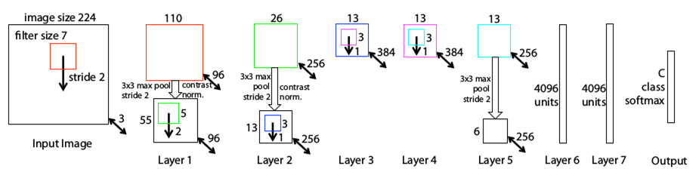
ZFNet
Build on top of AlexNet
Using 11x11 on the first layer’s filter is too large
Skipping too much information
More Trial and Error :(
[Zeiler and Fergus, 2013]
Computer Vision
Notes:
11x11,4 → 7x7,2
11x11 filter is too large, skipping way too much
Conv 345 use larger filters
Improved to 11% error after creating Clarifai

Slide 18
ZFNet
Use 7x7 stride 2 instead
Same number of filters
Layer 3,4,5 Same filter size
Increase the number (depth) to 512, 1024, 512
Same Pool size
[Zeiler and Fergus, 2013]
Computer Vision
Notes:
11x11,4 → 7x7,2
11x11 filter is too large, skipping way too much
Conv 345 use larger filters from 384,384,256
Improved to 11% error after creating Clarifai

Slide 19
ZFNet Details
Trained on only 1.3 million images.
Trained on a GTX 580 GPU for twelve days
Developed a visualization technique named Deconvolutional Network,
which helps to examine different feature activations and their relation to the input space.
[Zeiler and Fergus, 2013]
Computer Vision

Slide 20
ZFNet Details
Bigger network (better?),
More Memory
More FLOPS
Total parameters 62M
Pretraining unavailable
[Zeiler and Fergus, 2013]
Computer Vision

Slide 21
ImageNet 2013
Classification Winner
Top-5 error: 14.8%
From 15.4%
Improved in ClarifAI: 11.2%
[Zeiler and Fergus, 2013]
Computer Vision

Slide 22
Aside: Stacking Convolution
Computer Vision
Notes:
Conv = Computation workhorse that is doing a lot of the work in the network
How we can design efficient network architectures that combine many layers of convolutions to achieve some good results

Slide 23
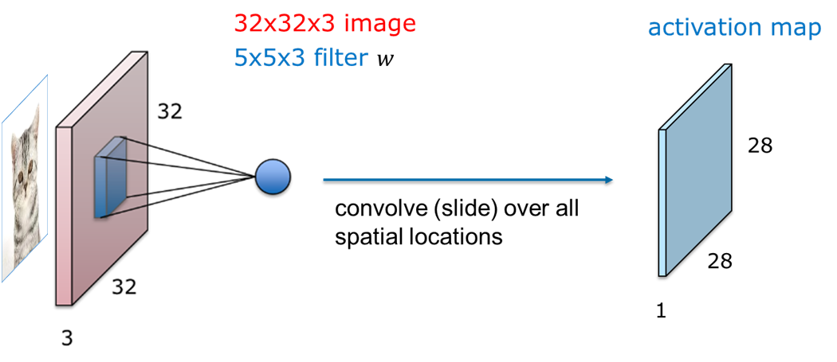
Receptive Field
We know that each filter in a spatial location result an activation in the feature map
Computer Vision

Slide 24
Receptive Field
Suppose we use a 3x3 conv layer (stride 1), resulting an activation map (activation 1)
Each neuron in activation 1 "sees" 3x3 region of previous layer (input)
input
activation 1
Computer Vision

Slide 25
Receptive Field
Now we stack two 3x3 conv layers, thus we have 2 activation maps
Again, Each neuron in activation 2 "sees" 3x3 region of previous layer (previous activation map)
input
activation 1
activation 2
Computer Vision

Slide 26
Receptive Field
Question: How big of a region of the input does a neuron on the second conv layer "see"?
input
activation 1
activation 2
Computer Vision

Slide 27
Receptive Field
Question: receptive field of two 3x3 conv layers
Answer: 5 x 5
input
activation 1
activation 2
Computer Vision

Slide 28
Receptive Field
Question: If we stack three 3x3 conv layers, how big of an input region does a neuron in the third layer see?
Computer Vision

Slide 29
Receptive Field
Answer: 7x7
 |  |  |  |  | x
 |  |  |  | x
Computer Vision

Slide 30
Receptive Field
Three layers of 3x3 conv gives similar representational power as a single layer of 7x7 convolution
Which is better?
 |  |  |  |  | x
 |  |  |  | x
Computer Vision

Slide 31
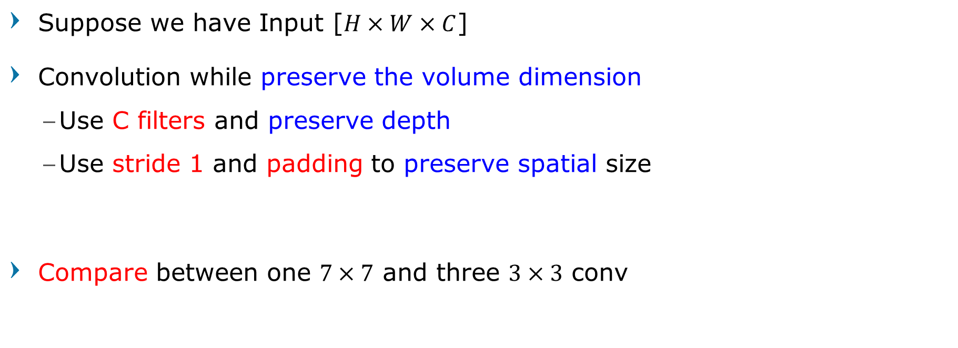
Comparing Receptive Field
Suppose we have Input [$H×W×C$]
Convolution while preserve the volume dimension
Use C filters and preserve depth
Use stride 1 and padding to preserve spatial size
Compare between one $7×7$ and three $3×3$ conv
Computer Vision

Slide 32
Comparing Receptive Field
[3x3xC] x C
[H x W x C]
← Which is Better? →
[3x3xC] x C
[7x7xC]
x C
Similar representational power
[3x3xC] x C
[H x W x C]
Computer Vision

Slide 33
Comparing Receptive Field
Convolution with stride 1 and padding to preserve H x W size
[HxWxC] input
1 conv+relu with C filters of 7x7xC
3 conv+relu with C filters of 3x3xC
Ultimately, 3@3x3 use more nonlinearity
[HxWxC] output
[HxWxC] output
Computer Vision

Slide 34
Comparing Receptive Field
[HxWxC] input
1 conv with C filters of 7x7xC
3 conv with C filters of 3x3xC
What is the number of parameters?
C x (7x7xC) = 49C²
3 x C x (3x3xC) = 27C²
Fewer parameters, more nonlinearity = GOOD
Computer Vision

Slide 35
Comparing Receptive Field
[HxWxC] input
1 conv with C filters of 7x7xC
3 conv with C filters of 3x3xC
What is the number of multiply-adds?
(HxWxC) x (7x7xC) = 49HWC²
3 x (HxWxC) x (3x3xC) = 27HWC²
Less computation, more nonlinearity = ALSO GOOD
Computer Vision

Slide 36
2014
Computer Vision

Slide 37
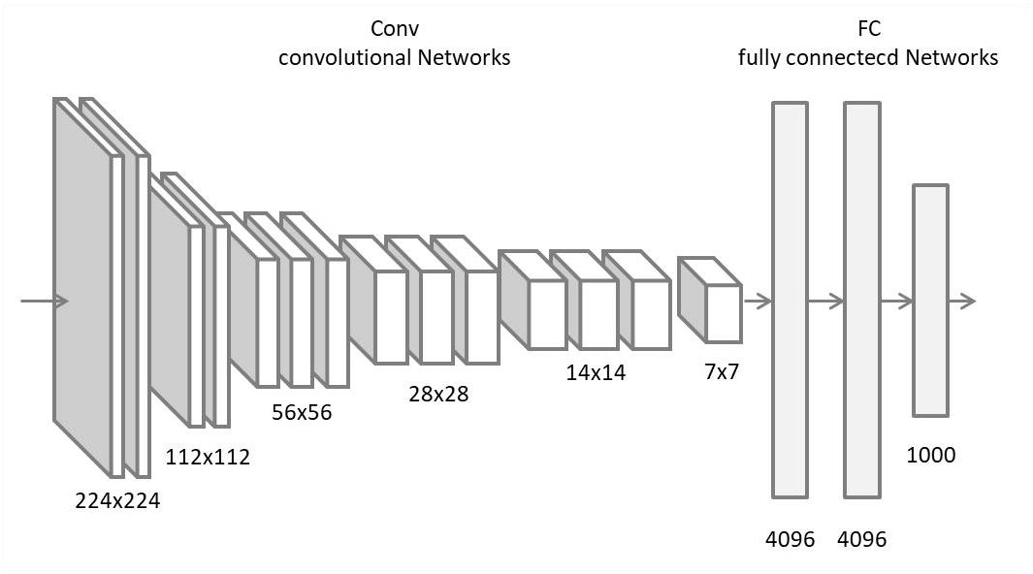
VGGNet
[Simonyan and Zisserman, 2014]
Computer Vision
Notes:
“Very Deep” CNN
Throughout the Net using the same filter and pool size
Only use 1 type of filter, just how many do they need to stack it
VGG from Visual Geometry Group

Slide 38
VGGNet
Rather than worrying about the architecture,
Just use the same filter and pool size throughout the net
The question is just how many stacks?
The more is better
Simplicity and Depth
[Simonyan and Zisserman, 2014]
Computer Vision
Notes:
“Very Deep” CNN
Throughout the Net using the same filter and pool size
Only use 1 type of filter, just how many do they need to stack it
VGG from Visual Geometry Group

Slide 39
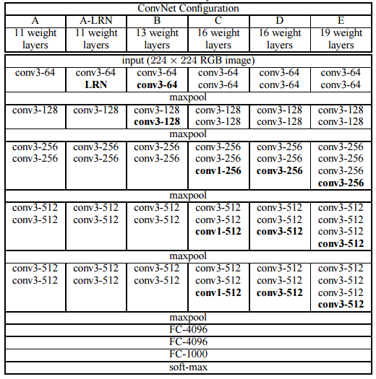
VGGNet
5 Conv Blocks
Stacks of 3x3 Conv layers stride 1 pad 1
Each block ended with Max Pooling stride 2
Double #channels after each block
3 FC Layers
[Simonyan and Zisserman, 2014]
Computer Vision
Notes:
“Very Deep” CNN
Throughout the Net using the same filter and pool size
Only use 1 type of filter, just how many do they need to stack it
VGG from Visual Geometry Group

Slide 40
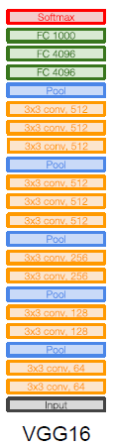
VGG16
16 layers
Input 224x224x3
2x Conv 64 (3x3), MaxPool (2x2)
2x Conv 128 (3x3), MaxPool (2x2)
3x Conv 256 (3x3), MaxPool (2x2)
3x Conv 512 (3x3), MaxPool (2x2)
3x Conv 512 (3x3), MaxPool (2x2)
FC 4096
FC 4096
FC 1000
[Simonyan and Zisserman, 2014]
Computer Vision
Notes:
“Very Deep” CNN
Throughout the Net using the same filter and pool size
Only use 1 type of filter, just how many do they need to stack it
VGG from Visual Geometry Group

Slide 41
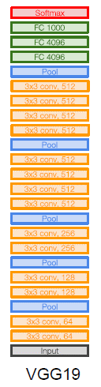
VGG19
19 layers
Input 224x224x3
2x Conv 64 (3x3), MaxPool (2x2)
2x Conv 128 (3x3), MaxPool (2x2)
4x Conv 256 (3x3), MaxPool (2x2)
4x Conv 512 (3x3), MaxPool (2x2)
4x Conv 512 (3x3), MaxPool (2x2)
FC 4096
FC 4096
FC 1000
[Simonyan and Zisserman, 2014]
Computer Vision
Notes:
“Very Deep” CNN
Throughout the Net using the same filter and pool size
Only use 1 type of filter, just how many do they need to stack it
VGG from Visual Geometry Group

Slide 42
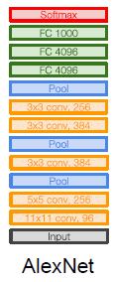
VGGNet
Smaller filters, deeper network
8 layers (AlexNet) → 16-19 layers
More non-linearities
[Simonyan and Zisserman, 2014]
Computer Vision
Notes:
“Very Deep” CNN
Throughout the Net using the same filter and pool size
Only use 1 type of filter, just how many do they need to stack it
VGG from Visual Geometry Group

Slide 43
VGGNet Details
"Very Deep" Convolutional Network
Number of filters doubles after each MaxPool layer.
Reinforces the idea of shrinking spatial dimensions, but growing depth.
Worked well on both image classification and localization task
Used ReLU layers after each conv layer and trained with batch gradient descent.
[Simonyan and Zisserman, 2014]
Computer Vision
Notes:
“Very Deep” CNN
Throughout the Net using the same filter and pool size
Only use 1 type of filter, just how many do they need to stack it
VGG from Visual Geometry Group

Slide 44
VGGNet Details
Built model with the Caffe toolbox.
Similar training procedure as AlexNet in 2012
Used scale jittering as one data augmentation technique during training.
Trained on 4 Nvidia Titan Black GPUs for two to three weeks.
[Simonyan and Zisserman, 2014]
Computer Vision
Notes:
“Very Deep” CNN
Throughout the Net using the same filter and pool size
Only use 1 type of filter, just how many do they need to stack it
VGG from Visual Geometry Group

Slide 45
ImageNet 2014
2nd Place in Classification
1st Place in Localization
Top-5 error: 7.3%
From 11.2%
Best Model : D (16 weight layers)
FC7 features generalize well to other tasks
[Simonyan and Zisserman, 2014]
Computer Vision

Slide 46
VGGNet
Pretraining available
Total parameters
138M (VGG16)
144M (VGG19)
compared to AlexNet 62M
Model size
528MB (VGG16)
550MB (VGG19)
[Simonyan and Zisserman, 2014]
Computer Vision

Slide 47
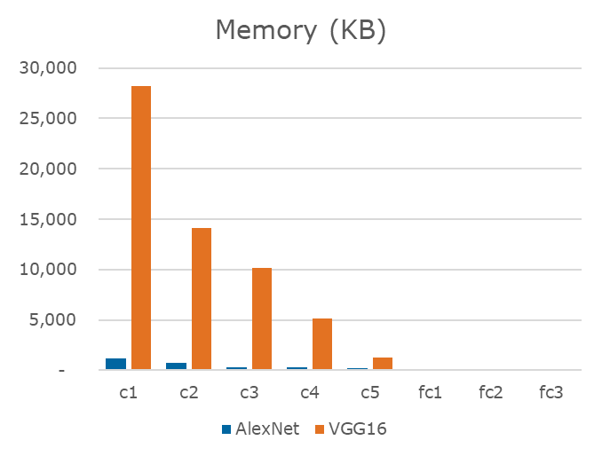
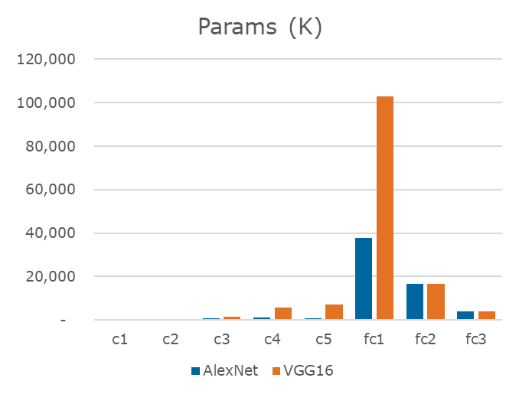
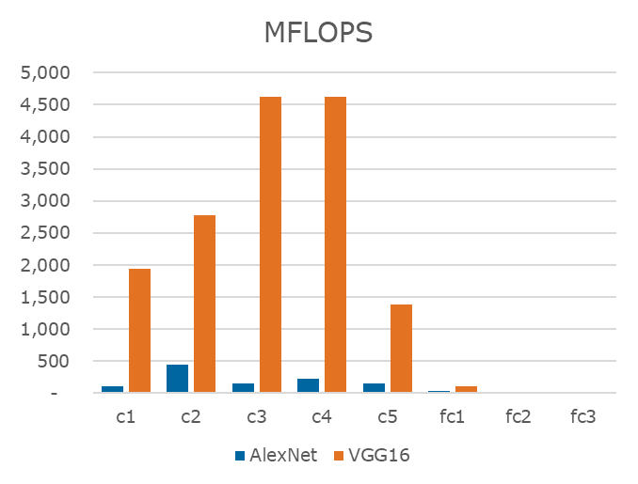
AlexNet vs VGG16
Computer Vision
Notes:
There was normalization layer at the time
In practice doesn’t really matter

Slide 48
Layer | Input size | Memory
INPUT | [224 x 224 x 3] | 150K
CONV3-64 | [224 x 224 x 64] | 3.2M
CONV3-64 | [224 x 224 x 64] | 3.2M
POOL2 | [112 x 112 x 64] | 800K
CONV3-128 | [112 x 112 x 128] | 1.6M
CONV3-128 | [112 x 112 x 128] | 1.6M
POOL2 | [ 56 x 56 x 128] | 400K
CONV3-256 | [ 56 x 56 x 256] | 800K
CONV3-256 | [ 56 x 56 x 256] | 800K
CONV3-256 | [ 56 x 56 x 256] | 800K
POOL2 | [ 28 x 28 x 256] | 200K
CONV3-512 | [ 28 x 28 x 512] | 400K
CONV3-512 | [ 28 x 28 x 512] | 400K
CONV3-512 | [ 28 x 28 x 512] | 400K
POOL2 | [ 14 x 14 x 512] | 100K
CONV3-512 | [ 14 x 14 x 512] | 100K
CONV3-512 | [ 14 x 14 x 512] | 100K
CONV3-512 | [ 14 x 14 x 512] | 100K
POOL2 | [ 7 x 7 x 512] | 25K
FC | [ 4096 ] | 4096
FC | [ 4096 ] | 4096
FC | [ 1000 ] | 1000
Most memory is in early CONV
TOTAL 24M * 4Byte = ~93MB/image, in forward pass
Double that for backward pass
Computer Vision
Notes:
M : memory, P : params
As the spatial decrease, the number of filter is increasing
Spatial shrink, but the depth increase
TOTAL memory: 24MB * 4 bytes ~= 93MB / image (only forward! ~*2 for bwd)
TOTAL params: 138M parameters
Most memory is in early CONV
Most params are in late FC

Slide 49
Layer | Input size | Memory | Parameters
INPUT | [224 x 224 x 3] | 150K | 0
CONV3-64 | [224 x 224 x 64] | 3.2M | (3*3*3) * 64 | = | 1,728
CONV3-64 | [224 x 224 x 64] | 3.2M | (3*3*64) * 64 | = | 36,864
POOL2 | [112 x 112 x 64] | 800K | 0
CONV3-128 | [112 x 112 x 128] | 1.6M | (3*3*64) * 128 | = | 73,728
CONV3-128 | [112 x 112 x 128] | 1.6M | (3*3*128) * 128 | = | 147,456
POOL2 | [ 56 x 56 x 128] | 400K | 0
CONV3-256 | [ 56 x 56 x 256] | 800K | (3*3*128) * 256 | = | 294,912
CONV3-256 | [ 56 x 56 x 256] | 800K | (3*3*256) * 256 | = | 589,824
CONV3-256 | [ 56 x 56 x 256] | 800K | (3*3*256) * 256 | = | 589,824
POOL2 | [ 28 x 28 x 256] | 200K | 0
CONV3-512 | [ 28 x 28 x 512] | 400K | (3*3*256) * 512 | = | 1,179,648
CONV3-512 | [ 28 x 28 x 512] | 400K | (3*3*512) * 512 | = | 2,359,296
CONV3-512 | [ 28 x 28 x 512] | 400K | (3*3*512) * 512 | = | 2,359,296
POOL2 | [ 14 x 14 x 512] | 100K | 0
CONV3-512 | [ 14 x 14 x 512] | 100K | (3*3*512) * 512 | = | 2,359,296
CONV3-512 | [ 14 x 14 x 512] | 100K | (3*3*512) * 512 | = | 2,359,296
CONV3-512 | [ 14 x 14 x 512] | 100K | (3*3*512) * 512 | = | 2,359,296
POOL2 | [ 7 x 7 x 512] | 25K | 0
FC | [ 4096 ] | 4096 | 7*7*512 * 4096 | = | 102,760,448
FC | [ 4096 ] | 4096 | 4096*4096 | = | 16,777,216
FC | [ 1000 ] | 1000 | 4096*1000 | = | 4,096,000
Most parameters are in FC Layers
Computer Vision
Notes:
M : memory, P : params
As the spatial decrease, the number of filter is increasing
Spatial shrink, but the depth increase
TOTAL memory: 24MB * 4 bytes ~= 93MB / image (only forward! ~*2 for bwd)
TOTAL params: 138M parameters

Slide 50
Aside: Stacking Convolution part 2
Computer Vision
Notes:
Conv = Computation workhorse that is doing a lot of the work in the network
How we can design efficient network architectures that combine many layers of convolutions to achieve some good results

Slide 51
Comparing Receptive Field
[3x3xC] x C
[H x W x C]
Three 3x3 is better
[3x3xC] x C
[7x7xC]
x C
Similar representational power
[3x3xC] x C
[H x W x C]
Computer Vision

Slide 52
The power of small filters
Why stop at 3x3 filters?
Why not try 1x1 filters?
“Bottleneck sandwich” convolution
Computer Vision

Slide 53
The power of small filters
“bottleneck” 1x1 conv to reduce dimension
Restore dimension with another 1x1 conv
[H x W x C]
[H x W x C]
[1x1xC] x C/2
[1x1xC] x C
[H x W x C/2]
[3x3xC] x C/2
[H x W x C/2]
3x3 conv at reduced dimension
Computer Vision

Slide 54
The power of small filters
[H x W x C]
Bottleneck Sandwich
[H x W x C]
[1x1xC] x C/2
[H x W x C/2]
[3x3xC] x C/2
[3x3xC] x C
[H x W x C/2]
Single 3x3 conv
[1x1xC] x C
[H x W x C]
[H x W x C]
Computer Vision

Slide 55
The power of small filters
[H x W x C]
3.25C² parameters
[H x W x C]
[1x1xC] x C/2
[H x W x C/2]
More nonlinearity!
Fewer parameters!
Less compute!
[3x3xC] x C/2
[3x3xC] x C
[H x W x C/2]
9C² parameters
[1x1xC] x C
[H x W x C]
[H x W x C]
Computer Vision

Slide 56
The power of small filters
[H x W x C]
6C² parameters
[H x W x C]
[1x3xC] x C
More nonlinearity!
Fewer parameters!
Less compute!
[H x W x C]
[3x3xC] x C
[3x1xC] x C
9C² parameters
[H x W x C]
[H x W x C]
Computer Vision

Slide 57
Aside: Network In Network
Computer Vision

Slide 58
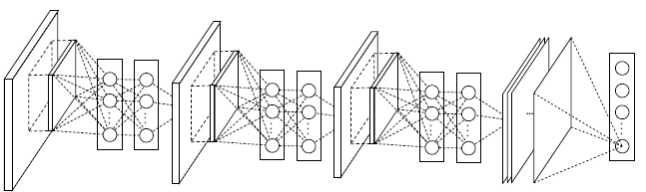
Network In Network
Integrating micro-network inside CNN structure
Introducing Global Averaging Pooling (GAP) to replace FC layer
[Lin, Chen, Yan 2014]
Computer Vision
Notes:
mimicking biological systems,

Slide 59

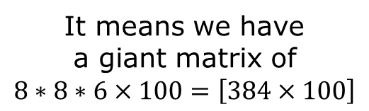
FC Layer after Conv Layer
Suppose we have output activation of $8×8×6$
Then after Flatten layer, if we use FC with $100$neurons
It means we have a giant matrix of
$$8∗8∗6×100=\left[384×100\right]$$
[Lin, Chen, Yan 2014]
Computer Vision
Notes:
mimicking biological systems,

Slide 60
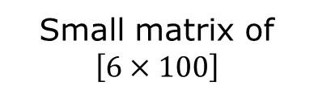
Global Average Pooling
Instead, we average over each feature map into one activation value
Explicitly confidence map of each category
Small matrix of
$$\left[6×100\right]$$
[Lin, Chen, Yan 2014]
Computer Vision
Notes:
mimicking biological systems,

Slide 61
Global Averaging Pooling
Generate one feature map for each corresponding category of the classification task
Intuition: average activation of this particular feature across the whole image
more native to the convolution structure by enforcing correspondences between feature maps and categories
the feature maps can be easily interpreted as categories confidence maps
[Lin, Chen, Yan 2014]
Computer Vision
Notes:
mimicking biological systems,

Slide 62
Global Averaging Pooling
no parameter to optimize in the global average pooling
overfitting is avoided
sums out the spatial information
it is more robust to spatial translations of the input.
[Lin, Chen, Yan 2014]
Computer Vision
Notes:
mimicking biological systems,

Slide 63
GoogLeNet
[Szegedy, 2014]
Computer Vision
Notes:
mimicking biological systems,

Slide 64
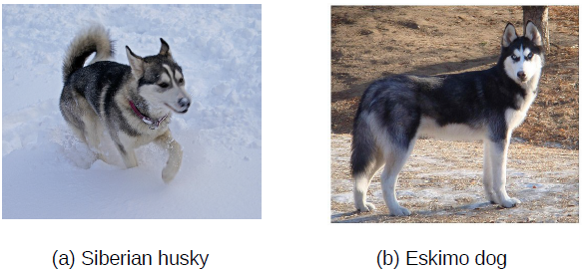
GoogLeNet
Problem with straightforward approach:
Increasing the size of network require bigger data
Otherwise overfit
[Szegedy, 2014]
Computer Vision
Notes:
mimicking biological systems,

Slide 65
GoogLeNet
Problem with straightforward approach:
If two convolutional layers are chained, any uniform increase in the number of their filters results in a quadratic increase of computation.
Dramatically increased use of computational resources
[Szegedy, 2014]
Computer Vision
Notes:
mimicking biological systems,

Slide 66
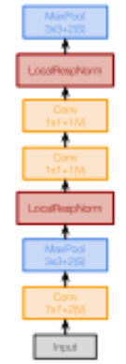
GoogLeNet
Solution 1: Aggressive Stem
Stem network at the start aggressively downsamples input
(Recall in VGG-16: Most of the compute was at the start)
From 224 to 28 spatial resolution
Computer Vision
Notes:
mimicking biological systems,

Slide 67
GoogLeNet
Solution 2:
moving from fully connected to sparsely connected architectures, even inside the convolutions
[Szegedy, 2014]
Computer Vision
Notes:
mimicking biological systems,

Slide 68
GoogLeNet
All of them are beneficial
1x1?
3x3?
5x5?
Pooling?
Which one we should use?
[Szegedy, 2014]
Computer Vision

Slide 69

GoogLeNet
[Szegedy, 2014]
Computer Vision
Notes:
mimicking biological systems,

Slide 70
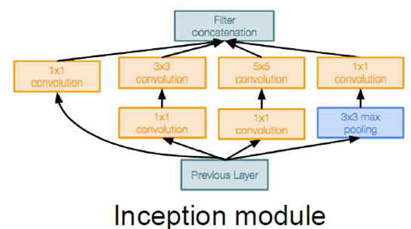
GoogLeNet: Inception Module
"Inception module": design a good local network topology (network within a network) and then stack these modules on top of each other
[Szegedy, 2014]
Computer Vision
Notes:
mimicking biological systems,

Slide 71
GoogLeNet: Inception Module
Number of filters
1x1
3x3
In images, correlations tend to be local
Cover more spread-out clusters by 3x3 convolutions
Less spread out correlations, use 1x1 convolution
[Szegedy, 2014]
Computer Vision
Notes:
mimicking biological systems,

Slide 72
GoogLeNet: Inception Module
Number of filters
1x1
3x3
5x5
Cover even more spread-out clusters by 5x5 convolutions
[Szegedy, 2014]
Computer Vision
Notes:
mimicking biological systems,

Slide 73
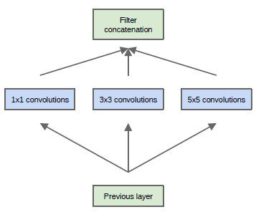
GoogLeNet: Inception Module
Number of filters
1x1
3x3
5x5
layer-by layer construction in which one should analyze the correlation statistics of the last layer and cluster them into groups of units with high correlation
[Szegedy, 2014]
Computer Vision
Notes:
mimicking biological systems,

Slide 74
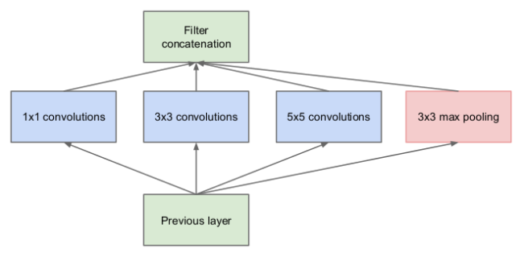
GoogLeNet: Naïve Inception Module
Output size?
A whooping 28 x 28 x 672
preserves feature depth
28x28x128
28x28x192
28x28x96
28x28x256
128
192
96
Pooling layer also preserves feature depth,
Input
28x28x256
[Szegedy, 2014]
Computer Vision
Notes:
mimicking biological systems,

Slide 75
GoogLeNet: Naïve Inception Module
Total depth after concatenation can only grow at every layer!
Conv Ops:
[1x1 conv, 128] = 28x28x128 x 1x1x256
[3x3 conv, 192] = 28x28x192 x 3x3x256
[5x5 conv, 96] = 28x28x 96 x 5x5x256
Total: 854M ops
Very expensive compute
[Szegedy, 2014]
Computer Vision
Notes:
mimicking biological systems,

Slide 76
Bottleneck Layer
Computer Vision

Slide 77
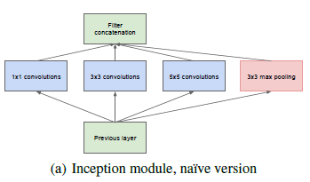
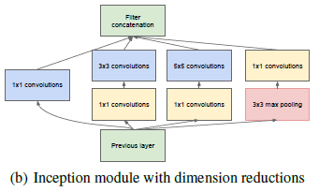
GoogLeNet: Inception Module
Naïve version did not work,
then comes the second version
1×1 convolutions are used to compute reductions before the expensive 3×3 and 5×5 convolutions.
[Szegedy, 2014]
Computer Vision
Notes:
mimicking biological systems,

Slide 78
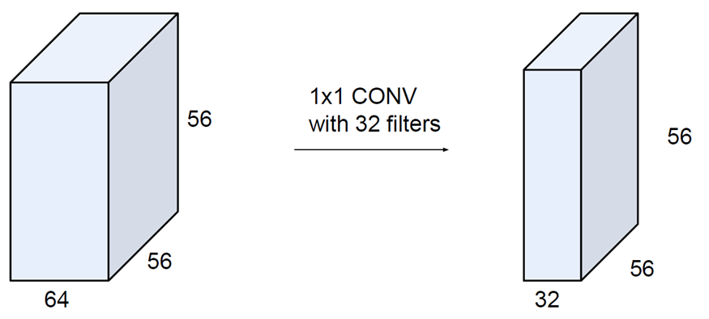
Bottleneck Layer
(each filter has size 1x1x64, and performs a 64-dimensional dot product)
Computer Vision

Slide 79
Bottleneck Layer
preserves spatial dimensions, reduces depth!
Projects depth to lower
dimension
(combination of feature maps)
Computer Vision

Slide 80
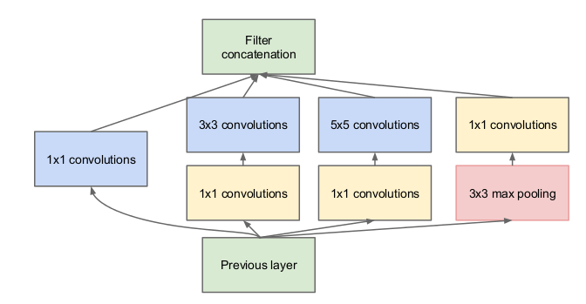
GoogLeNet: New Inception Module
Output size?
28 x 28 x 480
28x28x192
28x28x96
28x28x64
28x28x128
192
96
64
128
28x28x64
28x28x64
28x28x256
64
64
Input
28x28x256
[Szegedy, 2014]
Computer Vision
Notes:
mimicking biological systems,

Slide 81
GoogLeNet: New Inception Module
Conv Ops:
[1x1 conv, 64] = 28x28x 64 x 1x1x256
[1x1 conv, 64] = 28x28x 64 x 1x1x256
[1x1 conv, 128] = 28x28x128 x 1x1x256
[3x3 conv, 192] = 28x28x192 x 3x3x64
[5x5 conv, 96] = 28x28x 96 x 5x5x64
[1x1 conv, 64] = 28x28x 64 x 1x1x256
Total: 358M ops
Compared to 854M ops for naïve version
Bottleneck can also reduce depth after pooling layer
[Szegedy, 2014]
Computer Vision
Notes:
mimicking biological systems,

Slide 82
GoogLeNet: Inception Module
5x5
1x1
3x3
Average pooling
1x1
[Szegedy, 2014]
Computer Vision

Slide 83
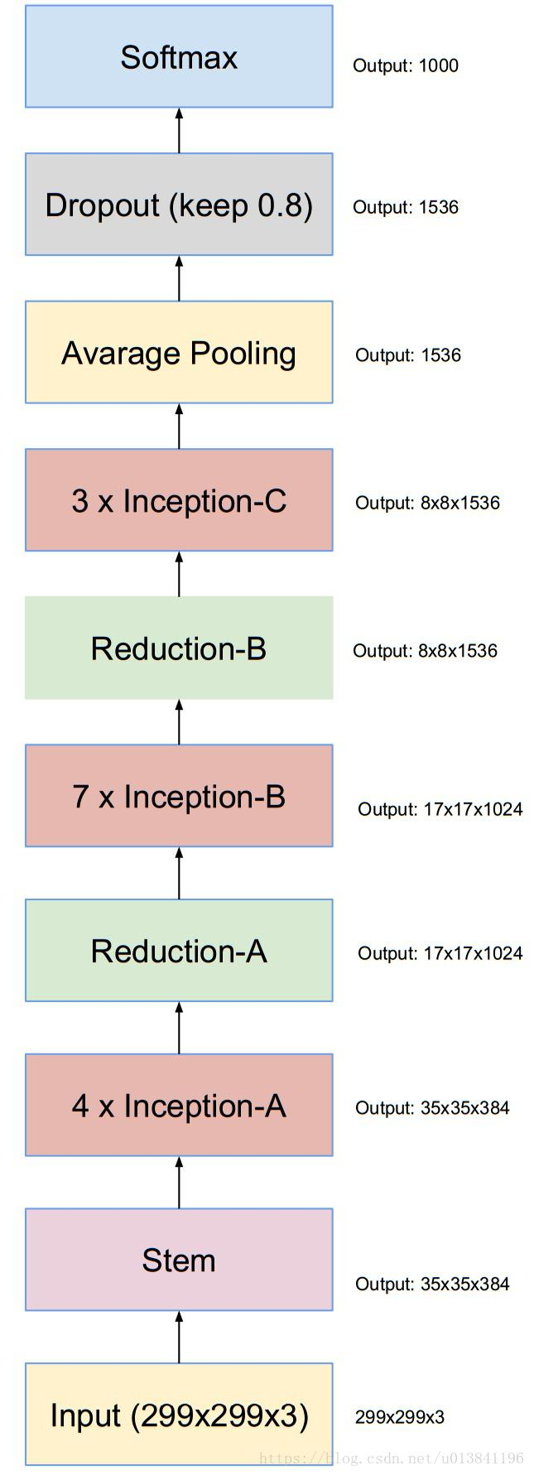
GoogLeNet Details
Deeper networks, with Computational Efficiency
Total 22 Layer with weights
Used 9 Inception modules in the whole architecture,
Equivalent with over 100 layers in total!
Now that is deep…!
[Szegedy, 2014]
Computer Vision

Slide 84
GoogLeNet Details
No use of large Fully Connected layers!
They use global average pool, to go from a 7x7x1024 volume to a 1x1x1024 volume.
This saves a huge number of parameters.
[Szegedy, 2014]
Computer Vision

Slide 85
GoogLeNet Details
Auxiliary Classifiers
Training using loss at the end of the network didn’t work well: Network is too deep; gradients don’t propagate cleanly
As a hack, attach “auxiliary classifiers” at several intermediate points in the network that also try to classify the image and receive loss
GoogLeNet was before batch normalization!
With BatchNorm no longer need to use this trick
[Szegedy, 2014]
Computer Vision

Slide 86
GoogLeNet Details
During testing, multiple crops of the same image were created, fed into the network, and the softmax probabilities were averaged to give us the final solution.
Utilized concepts from R-CNN (a paper we’ll discuss later) for their detection model.
There are updated versions to the Inception module
Versions 6 and 7
Trained on “a few high-end GPUs within a week”
[Szegedy, 2014]
Computer Vision

Slide 87
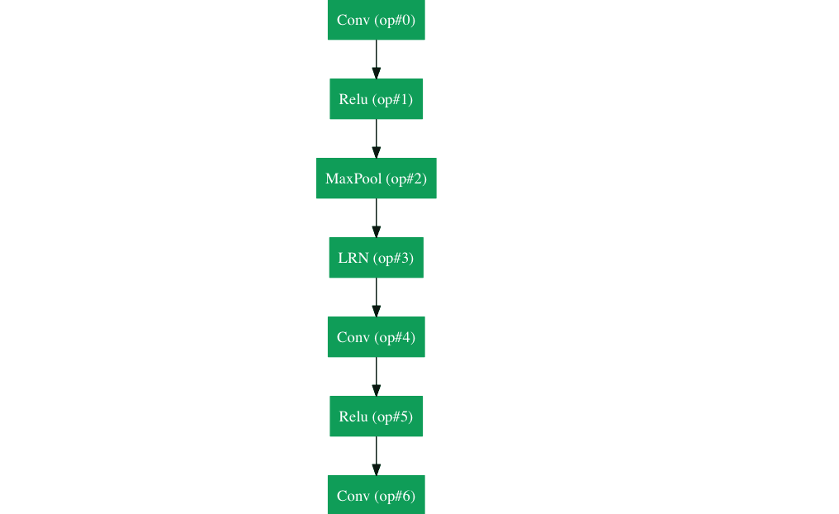
GoogLeNet
[Szegedy, 2014]
Computer Vision
Notes:
Introducing the inception modules
256-480-480-512-512-512-832-832-1024

Slide 88

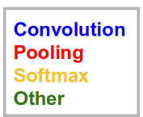
ImageNet 2014
1st Place in Classification
Top-5 error: 6.67%
From 7.3%
[Szegedy, 2014]
Computer Vision

Slide 89
GoogLeNet Details
Classifier output
(removed expensive FC layers!)
Stacked Inception
Modules
Stem Network:
Conv-Pool-
2x Conv-Pool
Auxiliary classification outputs to inject additional gradient at lower layers
(AvgPool-1x1Conv-FC-FC-Softmax)
[Szegedy, 2014]
Computer Vision
Notes:
Introducing the inception modules
256-480-480-512-512-512-832-832-1024

Slide 90
GoogLeNet Details
22 layers (equivalent to >100 Layers)
Input 224x224x3
Conv 32 (7x7, s=2), MaxPool (3x3, s=2)
Conv 32 (1x1, s=1),
Conv 32 (3x3, s=1), MaxPool (3x3, s=2)
4x Inception Module, output 1
3x Inception Module, output 2
2x Inception Module, Global Avg Pool
Dense 1000
1 Inception Module = 2 Layer Conv
[Szegedy, 2014]
Computer Vision

Slide 91
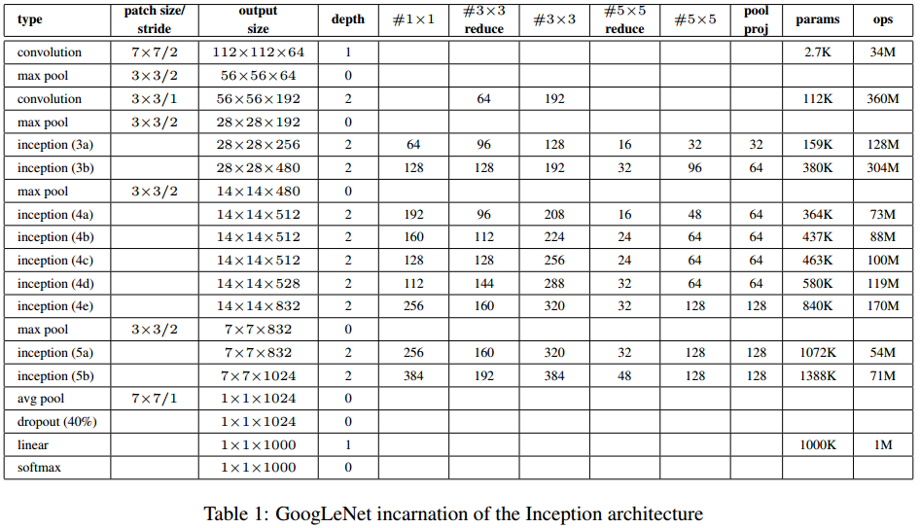
GoogLeNet Details
Only 5 million parameters!
12x less compared to AlexNet
(Removes FC layers completely)
2x more computation
[Szegedy, 2014]
Computer Vision
Notes:
Introducing averaging pool before FC layer
Compared to AlexNet:
- 12 x less params → VGG 140M, AlexNet 60M
- 2 x more compute
- 6.67% (vs. 16.4%)

Slide 92
GoogLeNet
Pretraining available
Total parameters
5M (GoogLeNet)
24M (InceptionV3)
compared to AlexNet 62M
Less parameters, more computation
Model size
94MB (InceptionV3)
[Szegedy, 2014]
Computer Vision

Slide 93
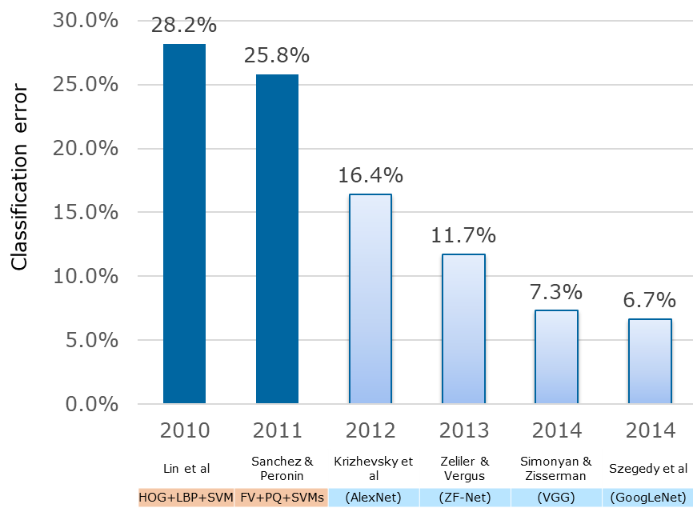
ImageNet Large Scale Visual Recognition Challenge (ILSVRC) Winners
Deeper Networks
19 layers
22 layers
shallow
8 layers
8 layers
Computer Vision

Slide 94
GoogLeNet vs VGGNet
In 2014, GoogLeNet is the WINNER
Yet, even in 2016 most people prefer to use VGGNet more than GoogLeNet
Simple structure, nice and uniform
Computer Vision
Notes:
mimicking biological systems,

Slide 95

Break, Question?
Computer Vision

